Slide 1



Musclehub a/b test
Ahmad ammash

Slide 2
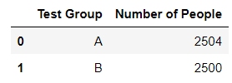
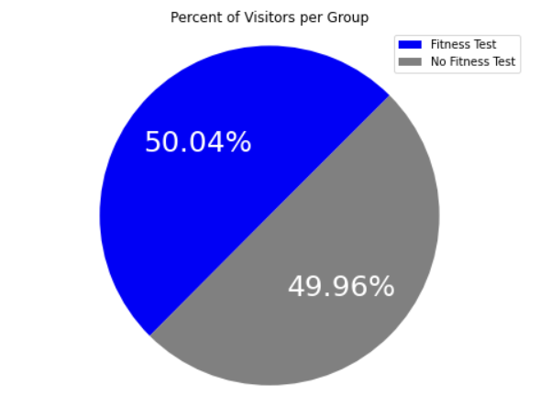
A briefing on musclehub’s a/b test
Visitors to MuscleHub were randomly and evenly split into two groups (A and B). Group A was asked to take a fitness test with a personal trainer ahead of applying for a membership. On the other hand, Group B skipped the fitness test and immediately proceeded to filling the application form if they wished to do so.
The goal is to test whether asking people to complete the fitness test will have a significant effect on the percentage of people who apply and pay for a membership.
This study compares the two visitor groups on 3 different levels:
The visitors who picked up an application vs those who didn’t.
The visitors who picked up an application and purchased a membership (as a percentage of the visitors who applied).
The visitors who purchased a membership (as a percentage of the total number of visitors from a specific group).

Slide 3
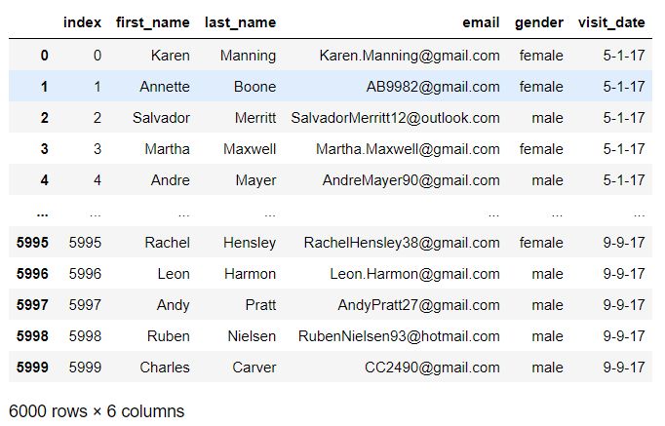
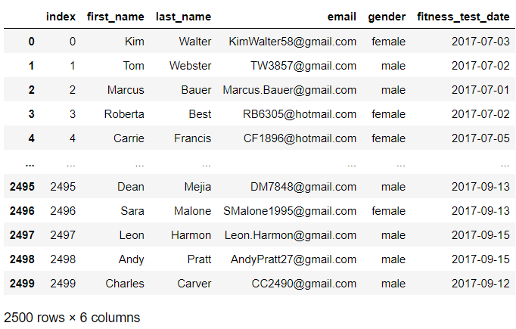
Dataset summary
The dataframe ‘visits’ contains data on the people who visited MuscleHub. Those people are potential customers.
This dataframe combines the people who were part of groups A and B i.e., those who did or did not do the fitness test.
The dataframe ‘fitness_tests’ contains information related to the visitors who were asked to do the fitness test with a personal trainer (those who were part of Group A).
Visits & fitness_tests dataframes

Slide 4
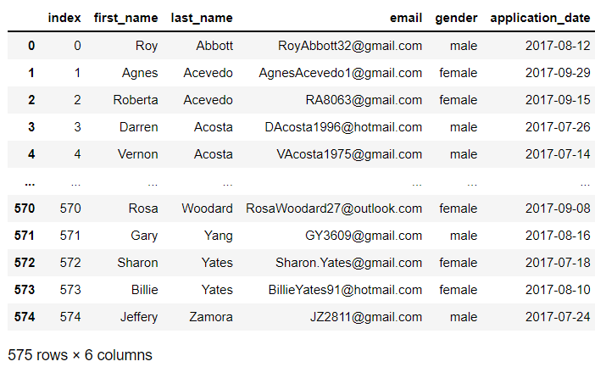
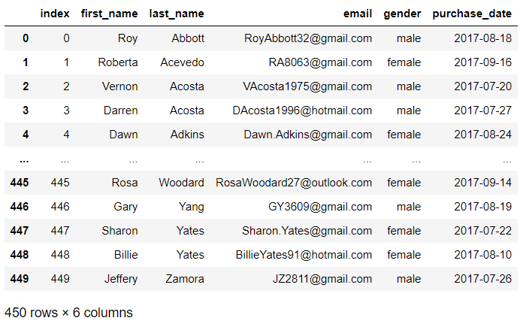
Dataset summary
The dataframe ‘applications’ contains information about visitors who filled out an application. Filled applications can come from visitors who were part of either Group A or B.
The dataframe ‘purchases’ contains information about visitors who purchased a membership at MuscleHub after filling the application form.
Applications & purchases dataframes

Slide 5
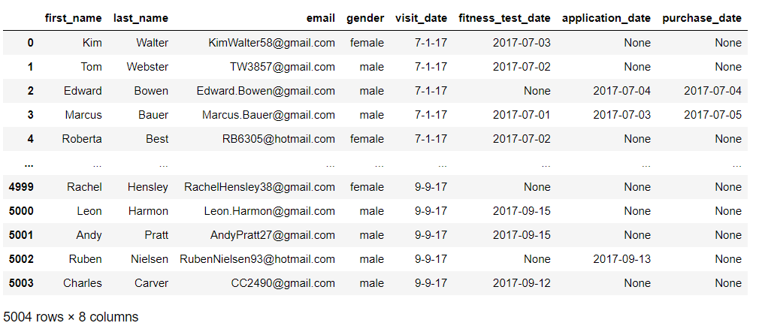
Dataset summary
This dataframe combines the 4 dataframes mentioned above (visits, fitness_tests, applications & purchases) into one. A “None” replaces the unknown values of the respective columns (e.g., a visitor who was not asked to do the fitness test or a visitor who did not apply/pay for a membership).
The combined dataframe

Slide 6
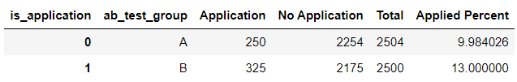
Hypothesis test #1
A chi squared (chi2_contingency) test was used to determine whether there is a significant difference between groups A and B in terms of the percentage of visitors who filled an application form.
The reason why we chose to use a chi squared test is that we’re studying the difference between 2 groups (categories) and we’re trying to know whether there is a significant difference between the values of a specific variable associated with each category (i.e., ‘Applied Percent’ in this case).
Using a contingency table from the above dataframe, we obtain a chi2_contingency p-value much less than the pre-set significance level of 5%. This means that the existence or absence of a fitness test has a significant effect on whether visitors proceed with filling the application form or not.
It is worth noting that the visitors who were not asked to do the fitness test were more likely to fill the application form.
Does the fitness test have a statistically significant effect on percent of applicants?

Slide 7
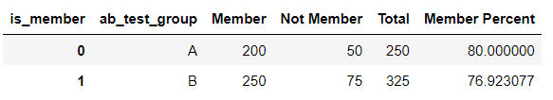
Hypothesis test #2
A chi squared (chi2_contingency) test was used to determine whether there is a significant difference between groups A and B in terms of the percentage of applicants (and only those who filled in an application form) paid for a membership.
Using a contingency table from the above dataframe, we obtain a chi2_contingency p-value much higher than the pre-set significance level of 5%.
This means that the existence or absence of a fitness test does not have a significant effect on whether applicants proceed with paying for a membership or not.
It is worth noting that the percentages of people who paid for a membership from each group are very similar.
Does the fitness test have a statistically significant effect on percent of applicants who became members?

Slide 8
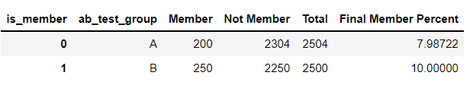
Hypothesis test #3
A chi squared (chi2_contingency) test was used to determine whether there is a significant difference between groups A and B in terms of the percentage of overall visitors who paid for a membership.
Using a contingency table from the above dataframe, we obtain a chi2_contingency p-value lower than the pre-set significance level of 5%.
This means that the existence or absence of a fitness test has a significant effect on whether a visitor proceeds with paying for a membership or not.
It is worth noting that the percentages of people who were not asked to complete the fitness test were more likely to become members.
Does the fitness test have a statistically significant effect on overall percent of visitors who became members?

Slide 9
Hypothesis test #2 vs test #3
There is one key difference between the second and third hypothesis tests.
The second hypothesis test only considers the visitors who completed an application. On the other hand, the third hypothesis test examines the percentage of overall visitors who became members.
The results of the second hypothesis test are not what we want to focus on. We want to study whether the fitness test (which we asked a group of visitors to complete) did have a significant (positive or negative) effect on how many visitors filled in an application form and/or proceeded to become members.
In conclusion, the results of hypothesis test #3 are considered to be the highlight of this study as the only way a gym can generate profit is through memberships (and not applications or visitor counts).
A comparison

Slide 10
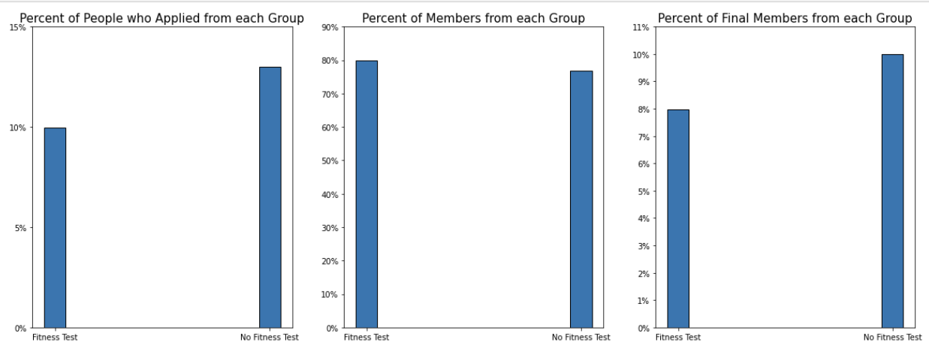
Visualizing the data
Which group of visitors had a higher number of applicants and members?

Slide 11
Outcome and recommendations
Based on the results of the three hypothesis tests and on the visualizations shown, we can conclude that the existence of a fitness test had a significant effect on whether a visitor would choose to become a member or not.
Furthermore, Group B is a clear winner in terms of the percent of visitors who became members (with an overall percentage of 10% compared to an 8% from Group A). By means of explanation, the fitness test had an adverse effect on the conversion rate of visitors to members.
Even though the results of hypothesis test #2 do not get along with what was mentioned above, this hypothesis test does not take into consideration all the visitors but only those who filled an application form (and this is not what we want).
A recommendation would be to forget about the fitness test and simply allow any visitor to come in, apply and pay for their membership as most of the newcomers and first-time visitors seem to be unfamiliar with working out and perhaps incapable (which is why some are finding the fitness test too intense).

